Slide 1


Practicum AI Lesson
Variables and Memory
Notes:
Hello and welcome to this Practicum AI recording.
I’m Dan Maxwell, the AI Trainer / Consultant for Research Computing.
In this briefing, I will introduce you to Python variables.
[NEXT SLIDE]

Slide 2


Variables
Notes:
In computer science, a variable is a named location in memory. Consider this clear plastic container with a variety of objects in it. Each object is a specific size and takes up a certain amount of space. Now think of this container as your computer’s memory. Each time you create and assign a specific value to a variable, the software allocates space in memory large enough to contain whatever you assign to it. Or using a container analogy, it creates a box to hold its value. The variable’s datatype determines the amount of memory required to hold it, just as we see in this picture. Behind the name you use for a variable, there’s a hidden address or pointer to its location or compartment in memory.
[NEXT SLIDE}

Slide 3
Python Variables
Python variables are dynamically declared
The data type is inferred by the data that is assigned (unless specifically defined)
Pros
Quick
Usually correct
Cons
May get unintended results
Doesn't flag errors
Name | Type | Value
a | int | 123
b | float | 3.1415
c | int | 4
d | float | 2.0
e | str | Hello
1 | a = 123
2
3 | b = 3.1415
4
5 | c = 4
6
7 | d = c / 2
8
9 | e = ‘Hello!’
Notes:
Python variables are dynamically declared
The data type is inferred by the data that is assigned (unless specifically defined)
Pros
Quick
Usually correct
Cons
May get unintended results
Doesn't flag errors
[NEXT SLIDE]

Slide 4
Variable name rules
Variable names (in Python) are case sensitive and MUST
Begin with a letter (or an underscore)
Not contain a space or a period (.)
Not be the same as a reserved keyword
But be careful these can override other functions!
Be unique (can’t be the same as another variable, function, or subroutine name)
Not more than 79 Characters (if this is a problem, you’re doing it wrong!)
Notes:
Variable names (in Python) are case sensitive and MUST
Begin with a letter (or an underscore)
Not contain a space or a period (.)
Not be the same as a reserved keyword
But be careful these can override other functions!
Be unique (can’t be the same as another variable, function, or subroutine name)
Not more than 79 Characters (if this is a problem, you’re doing it wrong!)
[NEXT SLIDE]

Slide 5
Reserved words
False | await | else | import | pass
None | break | except | in | raise
True | class | finally | is | return
and | continue | for | lambda | try
as | def | from | nonlocal | while
assert | del | global | not | with
async | elif | if | or | yield
Notes:
Every language has a set of reserved words. And Python is no exception. A reserved word cannot be used as a variable name. Best practice is to simply avoid these words altogether.
[NEXT SLIDE]

Slide 6
Variable Naming Conventions
Naming conventions are suggested, not required
Make your names intuitive, readable, concise, and consistent!
Begin variable names with a letter in lower case (“a” not “A”)
Use “camel casing” – capitalize each new “word” (myVar, sumDollars)
OR
Use underscores to separate each “word” (my_var, sum_dollars)
For longer programs, begin variables with prefix indicating variable type (strName, fltDollars)
Notes:
These naming suggests are recommended:
Make your names intuitive, readable, concise, and consistent!
Begin variable names with a letter in lower case (“a” not “A”)
Use “camel casing” – capitalize each new “word” (myVar, sumDollars)
OR
Use underscores to separate each “word” (my_var, sum_dollars)
For longer programs, begin variables with prefix indicating variable type (strName, fltDollars)
[NEXT SLIDE]

Slide 7
Operators
Notes:
Hello and welcome to this Practicum AI recording.
I’m Dan Maxwell, the AI Trainer / Consultant for Research Computing.
In this briefing, I will introduce you to the Python operators.
[NEXT SLIDE]

Slide 8
Python Arithmetic Operators
Addition +
Subtraction -
Multiplication *
Division /
Exponent (power) ** (3**2)
Grouping ( )
Integer (floor) Division //
Modulus %
Remainder i.e. 5 % 2 = 1
Notes:
Python has a wide variety of arithmetic operators.
Addition and Subtraction
Multiplication and Division
Exponent and Grouping
Integer (floor) Division and Modulus
[NEXT SLIDE]

Slide 9
Python Operators (Comparison)
Comparison Operators compare 2 numbers or strings
They always return a Boolean value (True or False)
Equal to == (note that this is different than ‘=‘)x
Less Than <
Greater Than > xxxxx xxxxxxxxxxxxxxxxxx
Less than or equal to <=
Greater than or equal to >=xx xxxxx xxxxxxxxxxxxxxxx
Not Equal to !=
(! is often called "bang" and stands for "not")
Notes:
Comparison Operators compare 2 numbers or strings. They always return a Boolean value (True or False).
Equal to – note the double equal signs
Less than
Greater than
Less than or equal to
Greater than or equal to
Not equal to
[NEXT SLIDE]

Slide 10
Other Operators
Logical Operators
and - evaluates to True if left and right sides are BOTH True (5 > 2) and (90 < 100)
or - evaluates to True EITHER left or right sides are True (5 < 2) or (90 < 100)
not - reverses True to False and vice versa
Identity Operators
is - returns true if both variables are the same object (more on this next lecture)
is not - returns true if both variables are NOT the same object
Membership Operators
in - returns true if specified sequence is present in the object (x in y)
not in - returns true if specified sequence in NOT in the object (x not in y)
Notes:
And a slew of other operators.
Logical Operators
and - evaluates to True if left and right sides are BOTH True (5 > 2) and (90 < 100)
or - evaluates to True EITHER left or right sides are True (5 < 2) or (90 < 100)
not - reverses True to False and vice versa
Identity Operators
is - returns true if both variables are the same object (more on this next lecture)
is not - returns true if both variables are NOT the same object
Membership Operators
in - returns true if specified sequence is present in the object (x in y)
not in - returns true if specified sequence in NOT in the object (x not in y)
[NEXT SLIDE]

Slide 11
Multiple assignment in Python
Python allows you to do multiple assignments in one line
Assign one value to multiple variables
x = y = z = 45
Assign multiple values to multiple variables (very pythonic!)
x, y, z = 1, 2, 'banana'
This is super handy for data structures
Notes:
Python allows you to do multiple assignments in one line.
Assign one value to multiple variables: x = y = z = 45
Assign multiple values to multiple variables (very pythonic!): x, y, z = 1, 2, 'banana’
This is super handy for data structures
[NEXT SLIDE]

Slide 12
Python Assignment Operators
Python has several augmented operators that allow assignment and operations to be done simultaneously (but no unary increment or decrement, ++ or -- )
Operator | Example | Equivalent to
= | x = 5 | x = 5
+= | x += 5 | x = x + 5
-= | x -= 5 | x = x - 5
*= | x *= 5 | x = x * 5
/= | x /= 5 | x = x / 5
%= | x %= 5 | x = x % 5
//= | x //= 5 | x = x // 5
**= | x **= 5 | x = x ** 5
Notes:
Python has several augmented operators that allow assignment and operations to be done simultaneously (but no unary increment or decrement, ++ or -- ).
These operators save typing time and are kind of neat.
[NEXT SLIDE]

Slide 13
Architecture (Interpreted Languages)
Interpreter
(Often Written in C)
CPU Virtual Machine
CPU Speaks
Binary Bits
& Bytes
>>> Cmd Line
ByteCode
CPU Speaks
Binary Bits
& Bytes
C / C++
Compiler
Executable
C Source File(s)
Notes:
Interpreted languages are much slower than compiled languages. When performance matters, an interpreted language may not be the best solution. If that’s the case with you, Nvidia provides the Cuda development environment which supports the C and C++ languages. These are compiled languages as opposed to interpreted.
[NEXT SLIDE]

Slide 14
DataTypes
Notes:
Hello and welcome to this Practicum AI recording.
I’m Dan Maxwell, the AI Trainer / Consultant for Research Computing.
In this briefing, I will introduce you to the Python data types.
[NEXT SLIDE]

Slide 15
Flow chart showing Python data types
Int
20
Numbers
Float
35.75
Bool
complex
True, False
1+3j
Python Data
Types
Set
{2, 4, 6}
Dict
String
{1:’a, 2:’b’}
‘Jessa’
List
Sequence
[2, ’a’, 5.7]
Tuple
[3, 4.5, ‘b’]
Image Credit: https://pynative.com/python-data-types/
Notes:
Python’s base datatypes are shown here.
Commonly used data types in core Python
Integer (int)
Float (float) - double-precision only, 64-bit
String (str) – delimited by single OR double quotes
Boolean (bool) – True / False
[NEXT SLIDE]
=====
https://pynative.com/python-data-types/

Slide 16

Functions for typecasting variables
int() | string, floating point to Integer
float() | string, integer to floating point number
str() | integer, float, list, tuple, dictionary to string
list() | string, tuple, dictionary to list
tuple() | string, list to tuple
This Photo by Unknown Author is licensed under CC BY-NC
Notes:
These functions allow you to typecast a variable of one type to another type.
[NEXT SLIDE]

Slide 17
Coding Style and Documentation
Notes:
Hello and welcome to this Practicum AI recording.
I’m Dan Maxwell, the AI Trainer / Consultant for Research Computing.
In this briefing, I will talk about coding style and documentation.
[NEXT SLIDE]

Slide 18
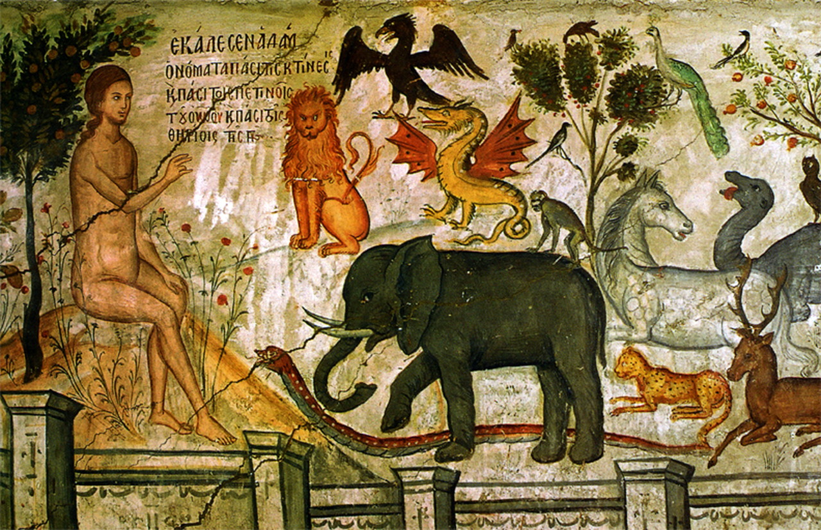
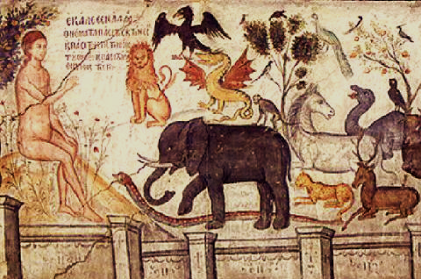
Classification is Important
Adam Naming the Animals, Theophanes the Cretan, Public domain, via Wikimedia Commons
Notes:
The imperative to properly name and classify things has existed for a long time. The Hebrew scriptures, for example, tell the story of how Adam named the animals. Here we see him doing just that in this medieval fresco. I especially like the image of the lion just above the elephant. Likewise, the names you assign to your variables and functions is critically important.
[NEXT SLIDE]

Slide 19
Python Comments
Inline comments
Precede with #
Multiline comments
Precede and end with triple single or double quotes – """
This is really a multiline string, but it works!
Use comments liberally!
Comments are for the future you!
They are also good for debugging, by activating or deactivating parts of your code
Notes:
And a few notes about Python Comments…
Inline comments
Precede with #
Multiline comments
Precede and end with triple single or double quotes – """
This is really a multiline string, but it works!
Use comments liberally!
Comments are for the future you – for when you come back to a piece of code at some point in the future.
They are also good for debugging, by activating or deactivating parts of your code
[NEXT SLIDE]

Slide 20
Strings
Notes:
Hello and welcome to this Practicum AI recording.
I’m Dan Maxwell, the AI Trainer / Consultant for Research Computing.
In this briefing, I will introduce you to the Python strings.
[NEXT SLIDE]

Slide 21
String example
String
T | h | i | s |  | i | s |  | a |  | s | t | r | i | n | g | !
Character
Notes:
In Python, individual characters are the building blocks of a string. A character can be an alphabetical letter, a blank space, or a special character – a punctuation mark, as we see here.
[NEXT SLIDE]

Slide 22
Strings and indexes
Character Value | S | a | n
Index Count | 0 | 1 | 2
Notes:
Keep in mind that Python indexes start at 0. As we see here, the first letter in this string (S) is at index position 0.
[NEXT SLIDE]

Slide 23
Escape Sequences
Escape Sequence | Meaning
\newline | Ignored
\ \ | Backslash ( \ )
\ ’ | Single quote (‘)
\ “ | Double Quote (“)
\a | ASCII Bell (BEL)
\b | ASCII Backspace (BS)
\f | ASCII Formfeed (FF)
\n | ASCII Linefeed (LF)
\r | ASCII Carriage Return (CR)
\t | ASCII Horizontal Tab (TAB)
\v | ASCII Vertical Tab (VT)
\ooo | ASCII character with octal value ooo
\xhh… | ASCII character with hex value hh…
Notes:
And here we see a list of escape sequences that can be embedded in your strings. Escape sequences are useful when you need to format a text string in a unique way.
[NEXT SLIDE]

Slide 24
Slide intentionally left blank

Slide 25

Jupyter
Notes:
Setup Instructions…

Slide 26
Operations and their symbols
Operation | Symbol
Addition | +
Subtraction | -
Multiplication | *
Division | /
Integer Division | / /
Exponentiation | **
Modulo/Remainder | %
Notes:
[NEXT SLIDE]

